Slide 1




Dockerizing full app lifecycle
Notes:
https://excalidraw.com/#json=qzjDACkA9Dj7EiZZ-_xRq,eVCFWBPZoce0CQsszEYMnA

Slide 2


Our experts:
Ivan Babanin
Akbarkhon Amirkhonov
Aliaksei Tsybulia
Lead Software Engineer
Lead Systems Engineer
Senior Software Test Automation Engineer

Slide 3
Agenda
1
2
3
Why Docker?
Improving test automation practice with Docker
Deploying containerized applications in Azure

Slide 4
Part 1 WHY DOCKER?

Slide 5

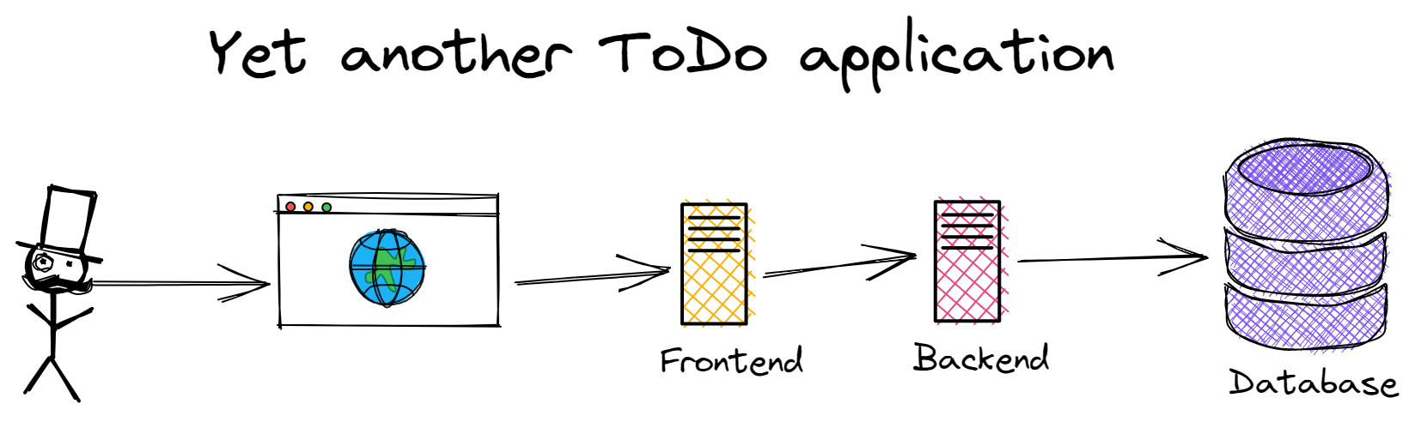
We are building…
Notes:
At the beginning, a little bit of a legend. Let's imagine we've decided to create yet another to-do application. We are not suited to the 1,000+ applications on the market, and we decided to develop our own because we want to get our million dollars from our users.
Like any modern application, ours will be comprised of three components: frontend written using React (for now without server side rendering), backend written using JDK 20 and based on Spring Boot framework and external database, let’s day it might be self-hosted PostgreSQL or managed PostgreSQL.

Slide 6
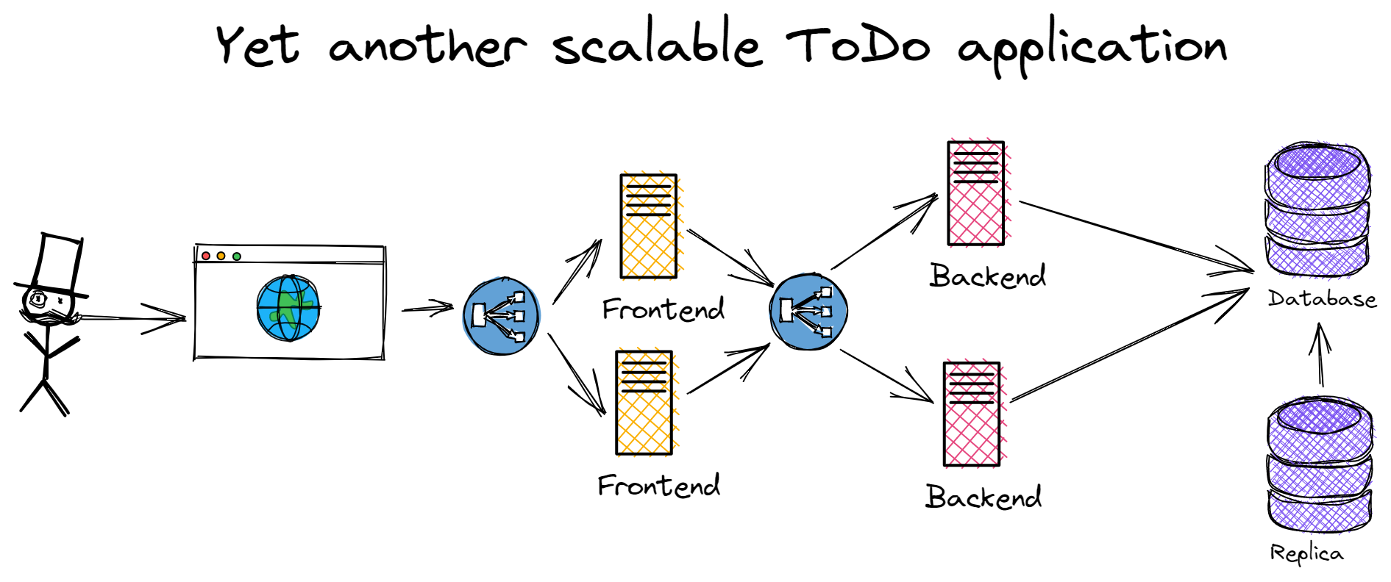
And even scalable and highly available…
Notes:
And, of course, we want to make it highly available and scalable, since you know, our millions are awaiting us.

Slide 7
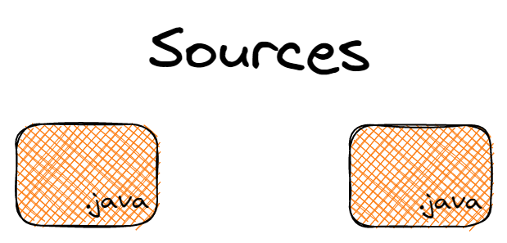
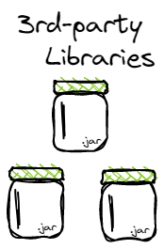
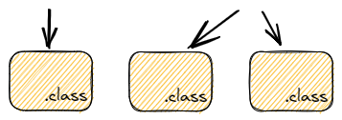
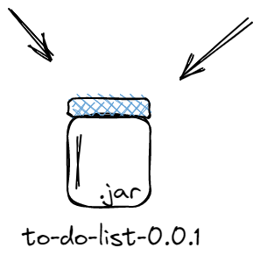
Let’s focus on backend part…
Typically we:
Choose build system (Maven/Gradle)
Write code
Add dependencies
Compile and test the code
Build deployment unit (JAR/WAR)
Notes:
As a backend developer, I will concentrate on the backend part.

Slide 8
Demo of backend project ⌨️
Notes:
Okay, we need to deploy it. What options do we have?

Slide 9
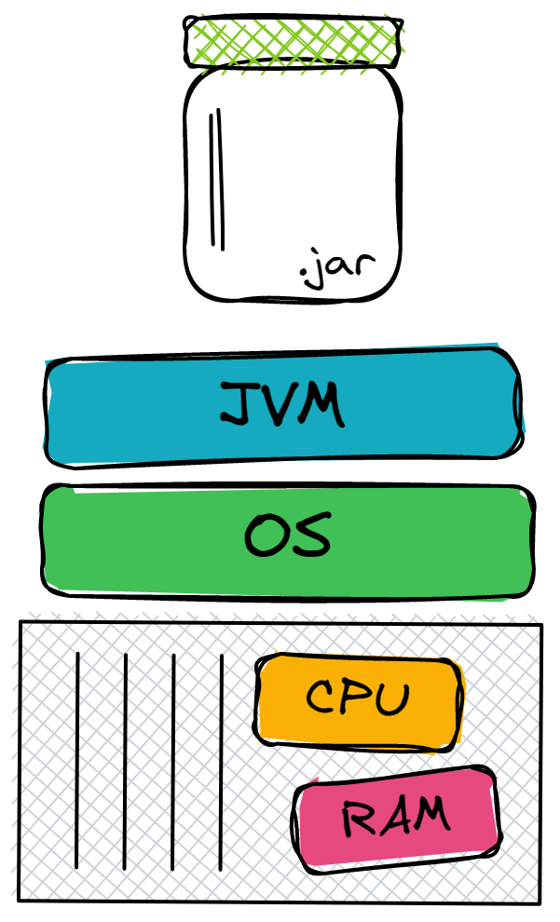
Let’s see how we can deploy it…
Deployment to physical machine has:
Doesn’t require any overhead layer
Hardware upgrades are difficult to implement and can lead to considerable downtime
Poor capacity optimization
Large upfront costs
Notes:
OK, the first quite obvious way is bare metal. We buy our own hardware, install some Linux distribution on it, install the JDK, set up a network, copy our wonderful JAR file and voila. Top performance.

Slide 10
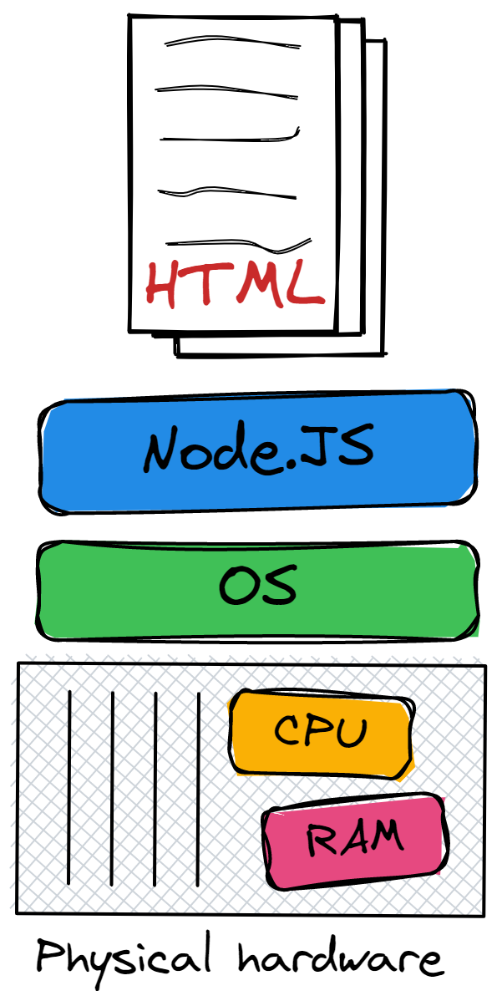
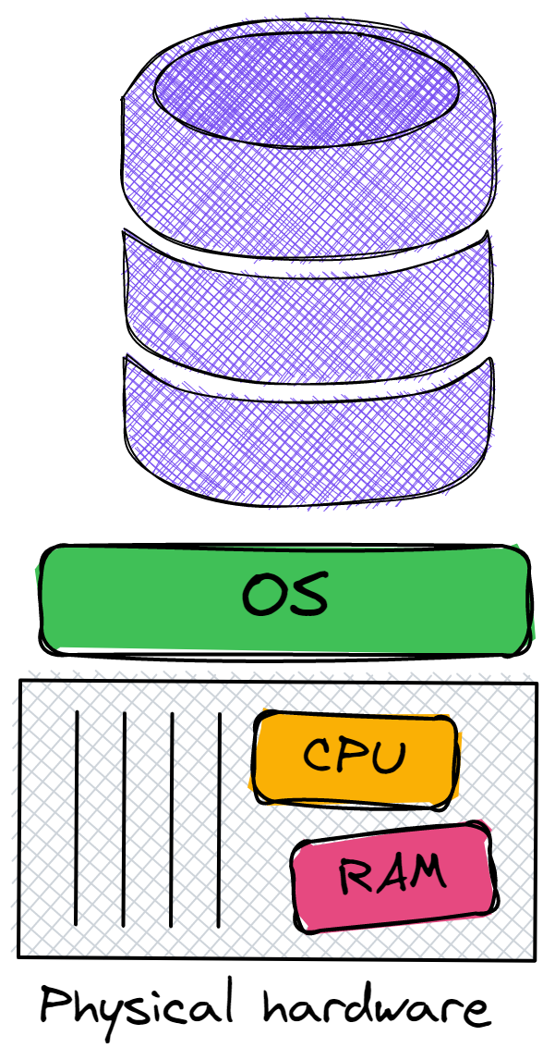
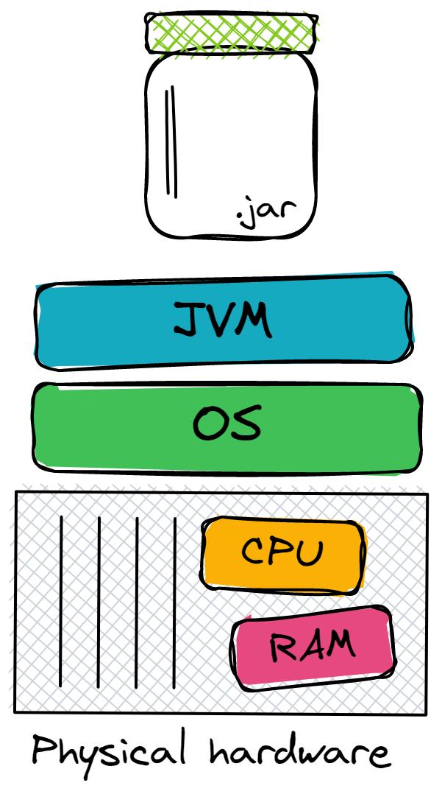
Let’s see how we can deploy it…
Deployment to physical machine has:
Doesn’t require any overhead layer
Hardware upgrades are difficult to implement and can lead to considerable downtime
Poor capacity optimization
Large upfront costs
Notes:
It’s not necessary to buy high-end computers to run the app, it still might be a commodity hardware, however for isolation purpose, we need to have separate server for backend, separate server for frontend and dedicated server for database. And since we are striving for availability, we need to have at least copy of each of them.

Slide 11
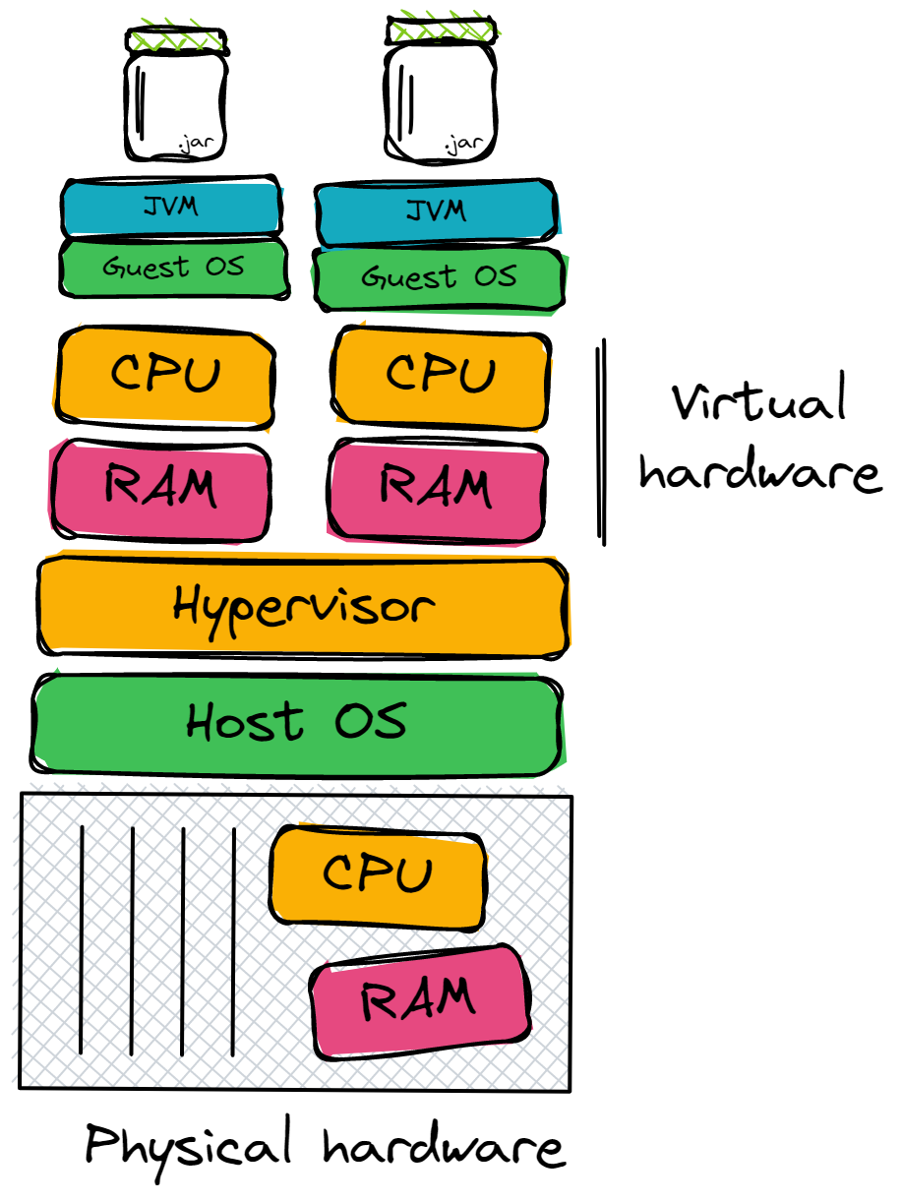
… or virtual servers?
Deployment to virtual machine:
Advanced capacity optimization is enabled by load balancing
Hardware upgrades are easier to implement
Security
VM software licenses
Some level of overhead is required for running VMs
Slow startup
Frequent deployment of the application might be risky
Notes:
Alright. What else we have… may be virtual machines?
Advanced capacity optimization is enabled by load balancing
Hardware upgrades are easier to implement - we can redistribute virtual machines, pull out the server from the cluster, perform upgrade and return server back.
VM software licenses
Some level of overhead is required for running VMs - guest OS with it’s kernel. By the way here I depicted so-called type 2 hypervisor, but there is also type 1.
Frequent deployment of the application might be risky - just as with physical machines, there is a problem with deployment. However, if a new version of the application requires a new version of the JDK - this can be time-consuming, especially if you have a lot of VMs… And not safe. There is always the risk that something will go wrong and the JDK, or even the OS, will not update correctly. Or the environment will start to diverge from one VM to another and we will start to catch sporadic bugs which are hard to reproduce.
And that’s the key point. Looks like beyond application itself, in our case uber-JAR file we need to include all other dependencies.
https://www.nakivo.com/blog/physical-servers-vs-virtual-machines-key-differences-similarities/

Slide 12
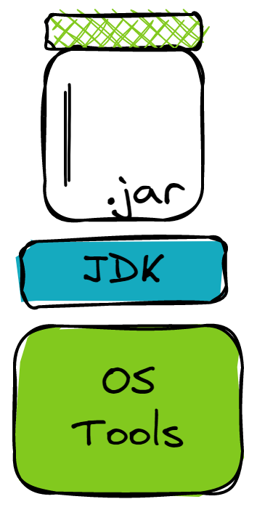
Ideal deployment unit?
What if we could create a single deployment unit which is:
Immutable
Includes applications
Includes all applications dependencies:
Libraries
Runtime environments (JVM/Node.JS)
Includes OS tools our application and runtime environment depend on
Notes:
Ideal deployment unit should include only what we really need: application, runtime execution and dependencies.

Slide 13
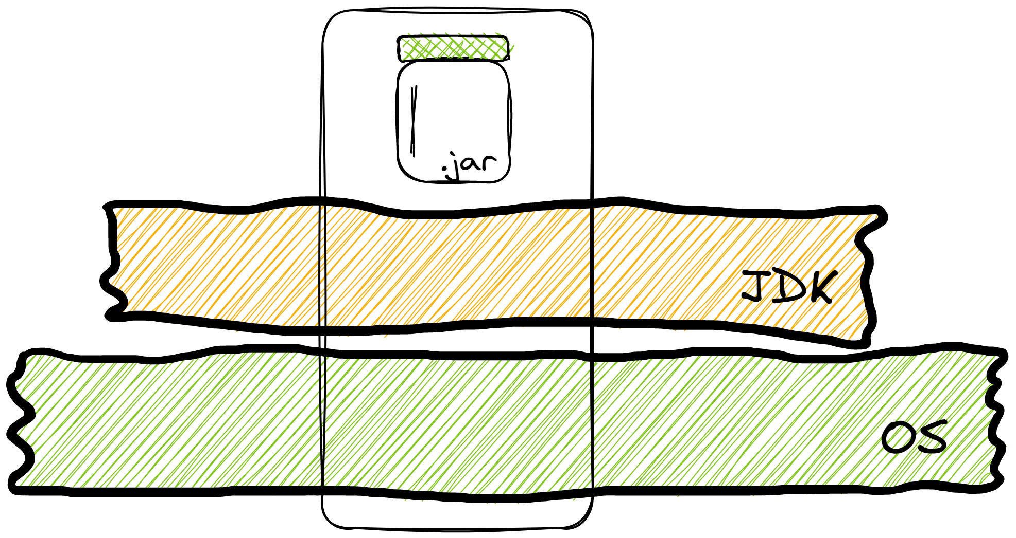
Instead of bringing whole JDK and OS, we take only we want…
Notes:
Instead of bringing JDK or whole operating system, we keep only what we need and depend on.

Slide 14

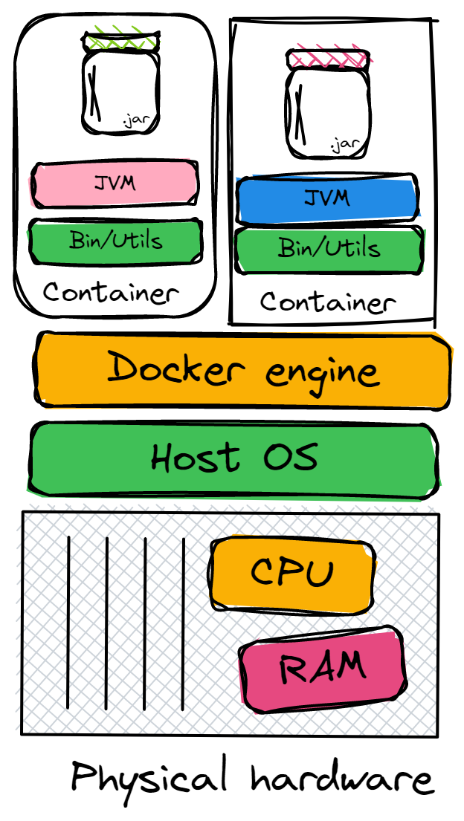
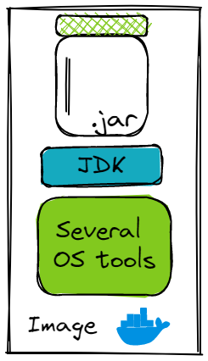
That’s actually are containers!
Supports virtualization
Has small size
Near-native performant
Replicable
Less secure
Compatibility with non-Linux operating systems
Notes:
And this is exactly what containers and container runtimes offer us! If we compare container to VM:
Supports virtualization - Both virtual machines and containers provide isolated environments to run applications. The key difference between the two is in how they facilitate this isolation. Recall that a VM boots up its own guest OS. Therefore, it virtualizes both the operating system kernel and the application layer. A container virtualizes only the application layer, and runs on top of the host operating system.
Size - A Docker image is lightweight and is typically in the order of kilobytes. By the way on the graph a Docker image denotes the artifact containing the application, its associated dependencies, and configuration. A running instance of the Docker image is called a container. A VM instance can be as large as a few gigabytes or even terabytes.
Near-native performant - In terms of performance, Docker containers provide near-native performance. Because they are lightweight, you can start them in a few milliseconds. Starting a VM is equivalent to setting up a standalone machine inside your computer. It can take as long as a few minutes to start a VM instance.
Replicable - We can infer the ease of replicability from our earlier discussions on size and performance. When there are multiple applications, each of which should run on a VM instance, using VMs can be inefficient and resource intensive. Docker containers, by virtue of being lightweight and performant, are preferred when you need to run multiple applications.
However containers have a couple of drawbacks compared to VMs:
Security - Docker containers run on top of the host operating system. Therefore, if the host OS is susceptible to security vulnerabilities, so are the Docker containers. Virtual machines, on the other hand, boot up their own operating system, and are more secure.
Compatibility - A virtual machine uses its own operating system and is independent of the host operating system that it’s running on. Therefore, a VM is compatible with all operating systems. Dockers make use of the execution engine, which is heavy relies on capabilities available only in Linux kernel. You may run into some problems running Docker on a Windows machine or an older Mac.
https://www.tutorialworks.com/difference-docker-containerd-runc-crio-oci/
https://geekflare.com/docker-vs-virtual-machine/
https://www.freecodecamp.org/news/docker-vs-vm-key-differences-you-should-know/
https://learn.microsoft.com/en-us/virtualization/windowscontainers/about/containers-vs-vm
https://cloudacademy.com/blog/docker-vs-virtual-machines-differences-you-should-know/

Slide 15
Demo of Dockerfile ⌨️
Notes:
Okay, looks like containers is what we need and a way to go. Let’s build containers for backend and frontend.
We are going to create a Dockerfile which is a simple text file with a set of instructions. These instructions are executed successively to perform actions on the parent image to create a new Docker image.

Slide 16
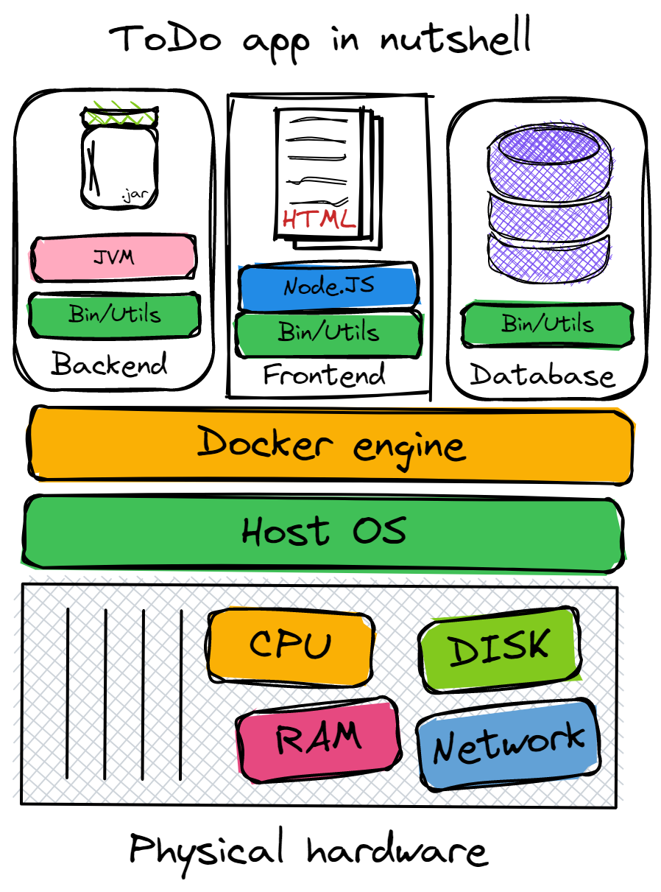
We are ready to deploy!

Slide 17
Part 2 Deploying containerized applications in Microsoft Azure

Slide 18


Join
DevOps Uzbekistan community

Slide 19
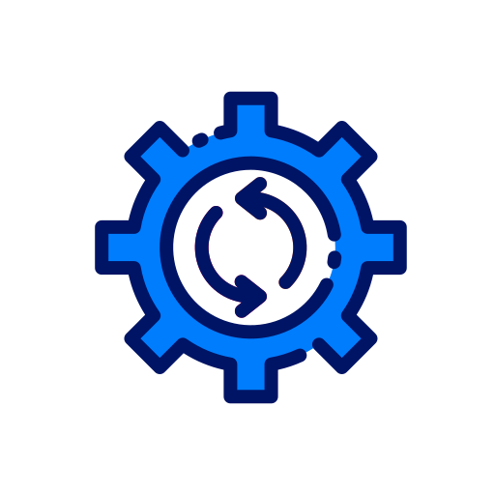
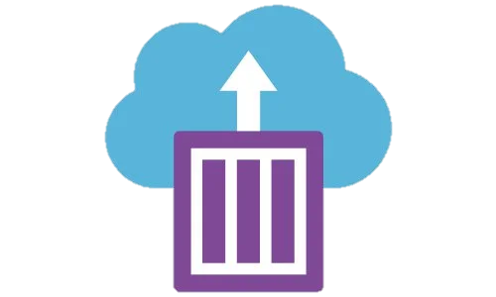
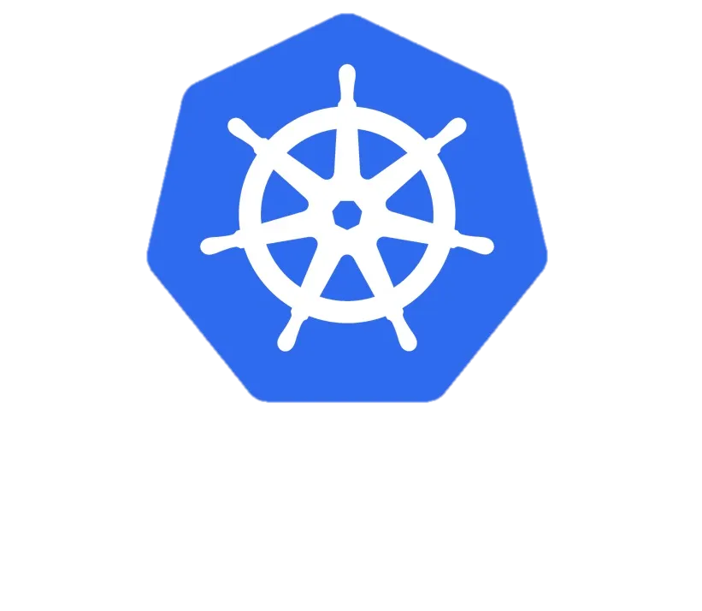
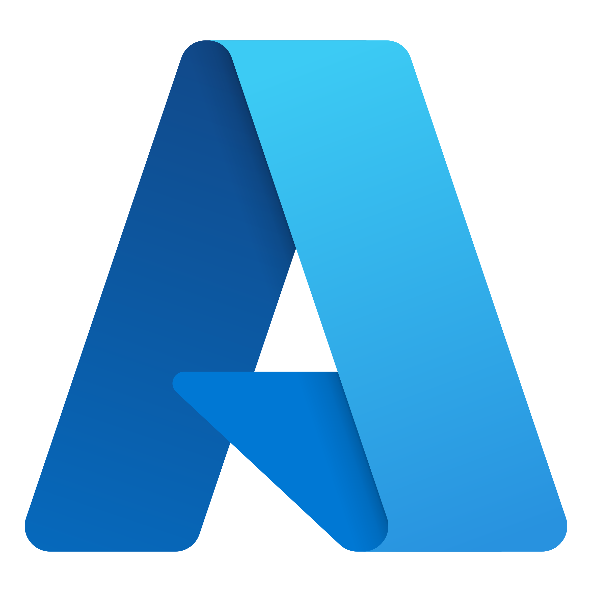

Agenda:
Overview of Azure container solutions
Introduction to Azure Kubernetes Service
What did we have before configuring automated deployments?
Provisioning Azure resources using Azure Portal
Deploying applications with GitHub Actions

Slide 20
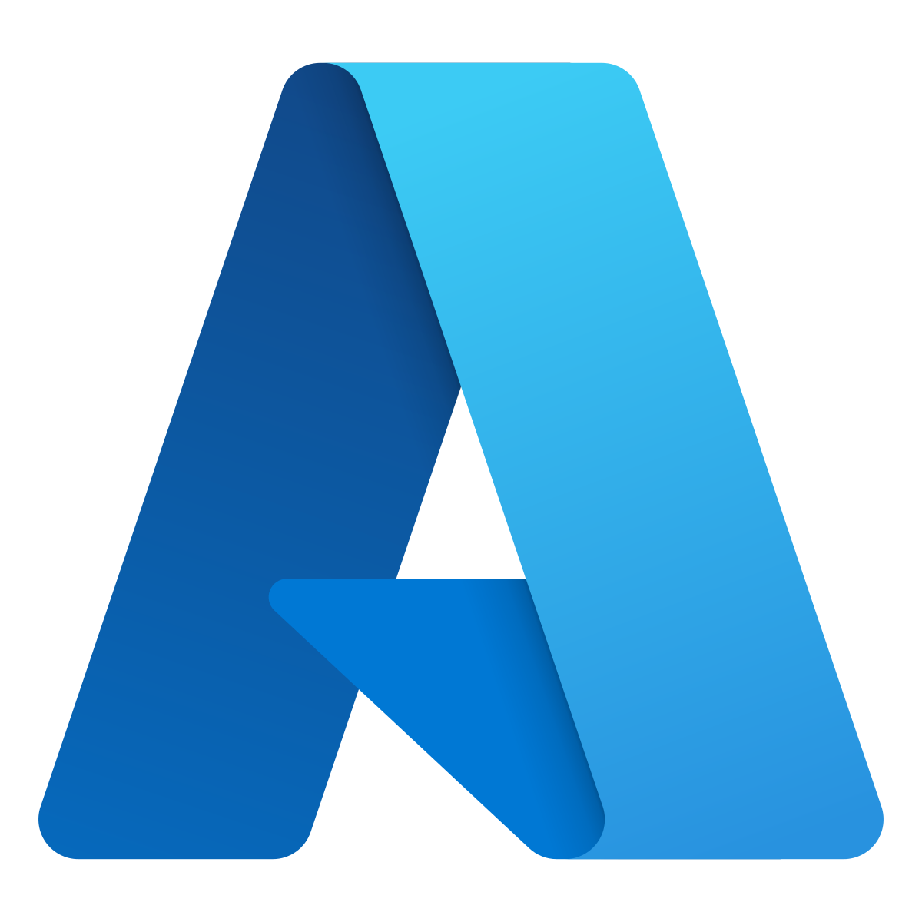
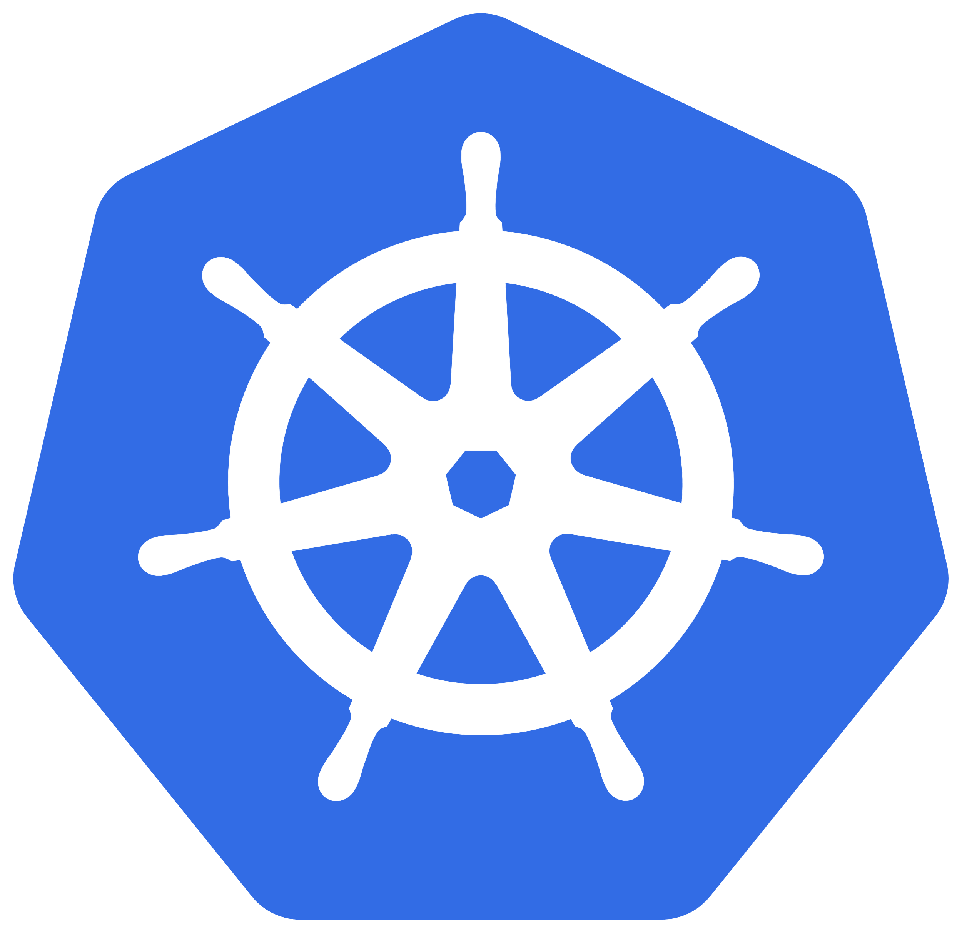
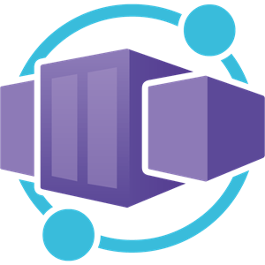
Overview of Azure container solutions
Service | Description
Azure Container Apps | Managed Serverless platform for running containerized applications
Azure WebApp for Containers | HTTP-based service for hosting web applications, REST APIs, and mobile backends. Optimized for web apps.
Azure Container Instances | a great solution for any scenario that can operate in hypervisor-isolated containers. Users often interact with it through other Azure services.
Azure Kubernetes Service | Managed orchestration for containerized application deployment
Azure Functions | Event-driven serverless computing for building scalable applications
Azure Spring Apps | Simplified deployment of Spring Boot applications on Azure
Azure Red Hat OpenShift | Managed Red Hat OpenShift service for containerized app development

Slide 21
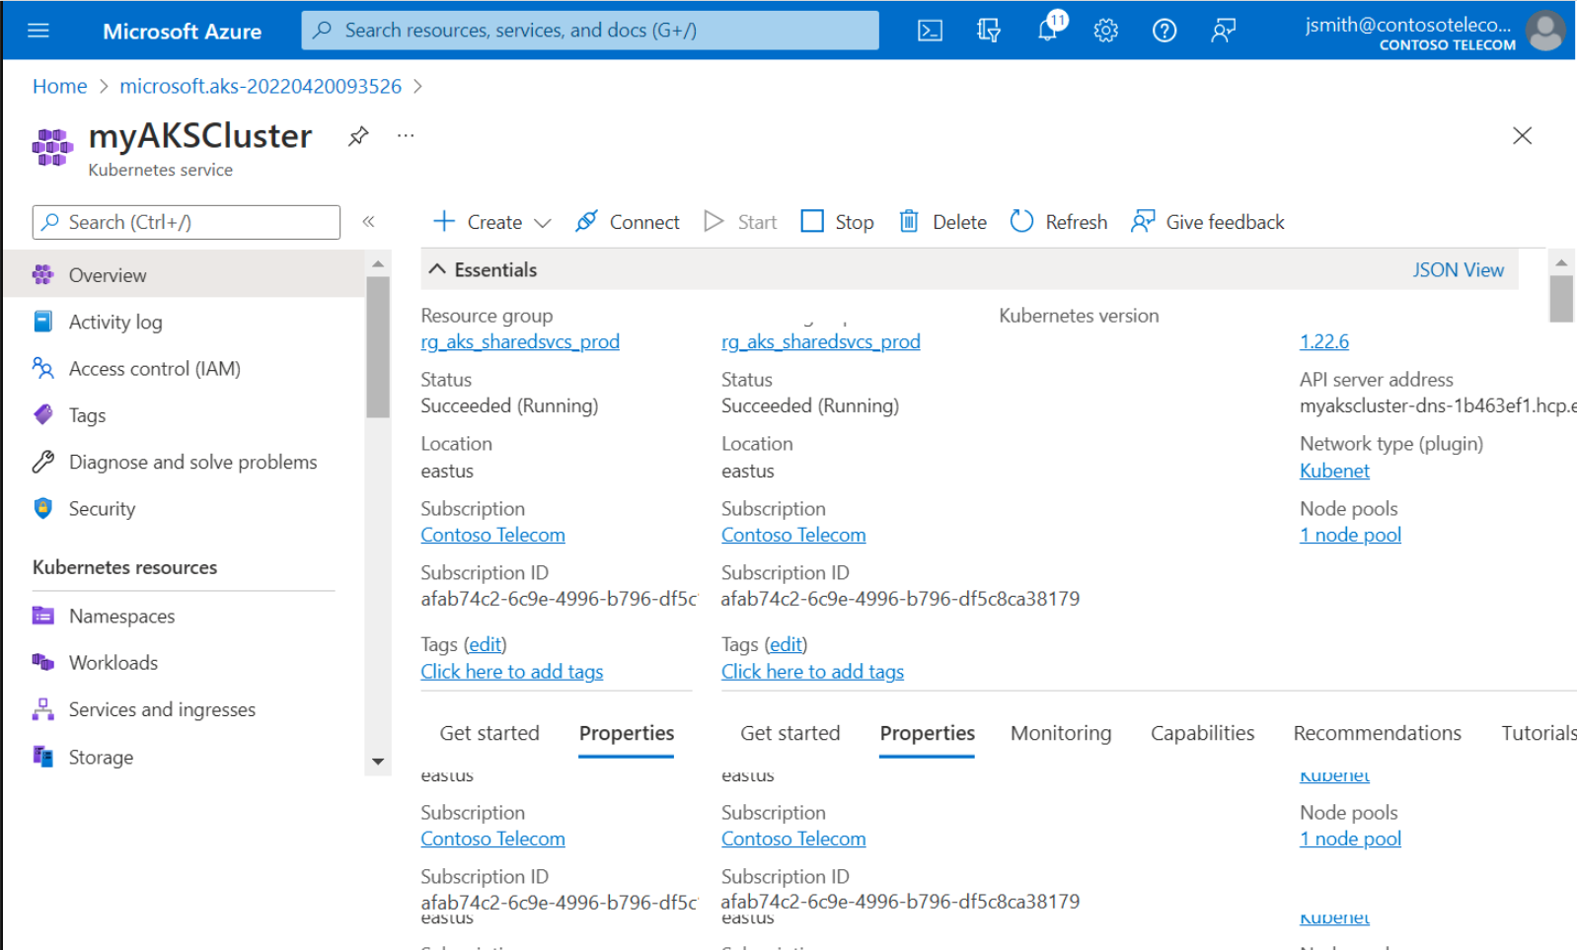
Introduction to Azure Kubernetes Service
Key features:
Managed Kubernetes Service
Automatic Scaling
GPU-enabled nodes
High Availability
Seamless Integration with Azure Services
Security and Compliance
Azure Active Directory Integration
Monitoring and Logging
Continuous Deployment and CI/CD
Multi-Region Availability
Cost Optimization
AKS has been CNCF-certified as Kubernetes conformant.
AKS is compliant with SOC, ISO, PCI DSS, and HIPAA

Slide 22
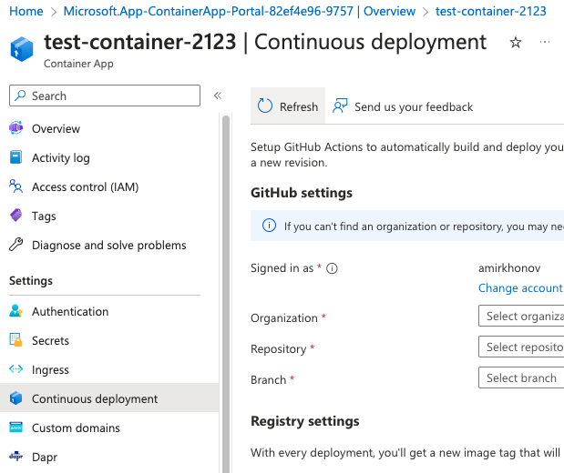
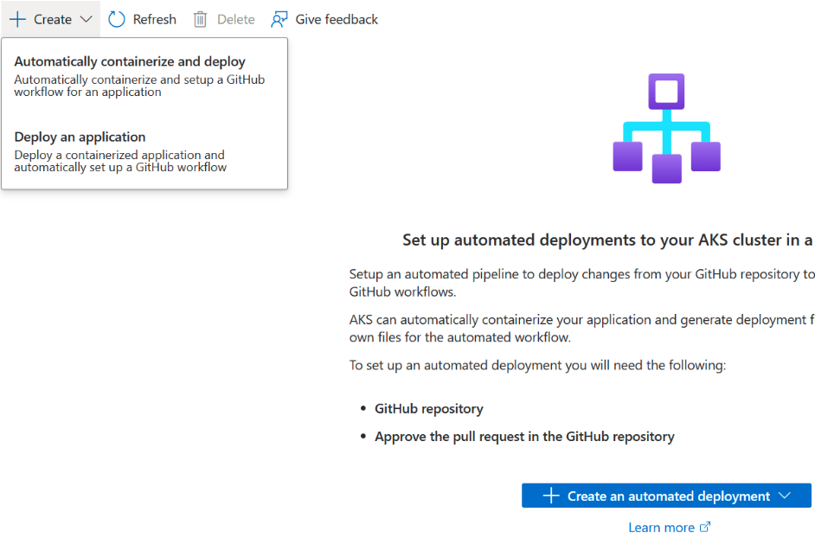
Automated deployments
Azure Container Apps
Azure Kubernetes Service

Slide 23
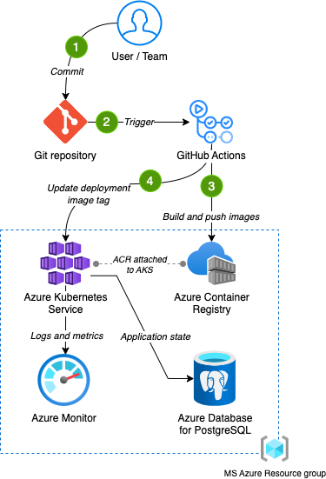
Before implementing a simple CI/CD
What we have:
GitHub repositories and GitHub Actions
Dockerfiles
Kubernetes manifests
Microsoft Azure subscription
Knowledge and experience ☺
What else do we need to implement CI/CD:
GitHub Actions workflows (pipelines)
Azure Container Registry
Azure Kubernetes Service
Azure Database for PostgreSQL flexible server

Slide 24
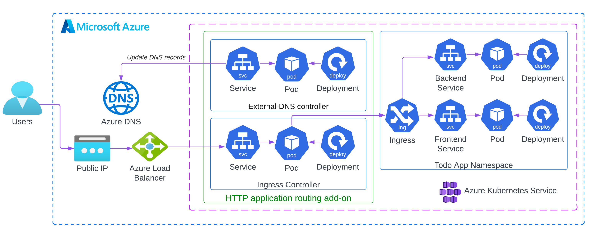
Azure Kubernetes Cluster high-level diagram

Slide 25
Part 3 Improving test automation practice with Docker

Slide 26

Staging environment tests
PROS:
Full integration
Easy to access
Easy to write tests
Suitable for automation and manual testing
Allow not to prepare testing data
Available for every team member
CONS:
Connectivity issues
Low performance with full integration
Testing data preparation
Testing data conflicts
As a result long regression testing

Slide 27
Local environment tests
PROS:
No connectivity issues
Higher performance with full integration
Only your own testing data
No testing data conflicts
As a result regression testing is faster
CONS:
Need to build and run application
Tools and knowledge for build and run
Access for the tools

Slide 28
Local environment tests with Docker
PROS:
No need to build and run app manually
No need in tools and knowledge for build and run
No need for access for the tools
CONS:
Need to run all the app infrastructure

Slide 29
Local environment tests with Docker and stubbed backend
PROS:
No need to run all the app infrastructure
Docker containers with stubbed services and backend are lighter then the real ones
As a result application is working faster

Slide 30
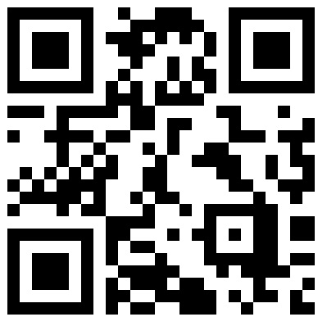
Join us😎

Slide 31

Thanks!

